Slide 1
BRITISH AIRWAYS (BA)
PREDICTING CUSTOMER BUYING BEHAVIOUR

Slide 2

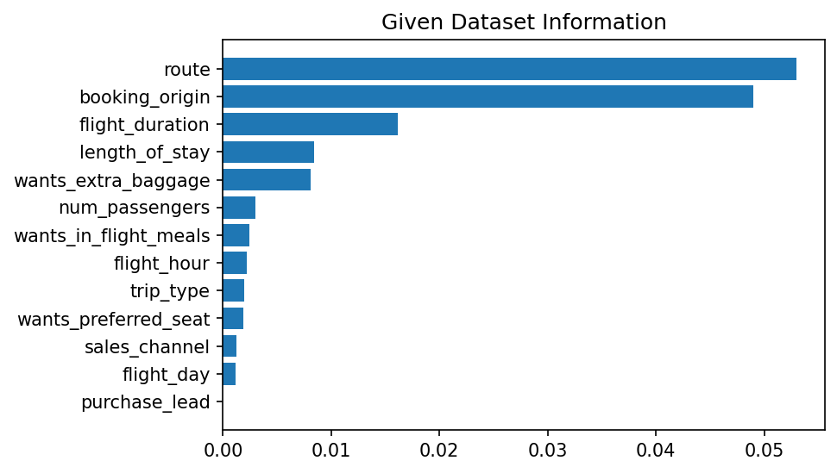
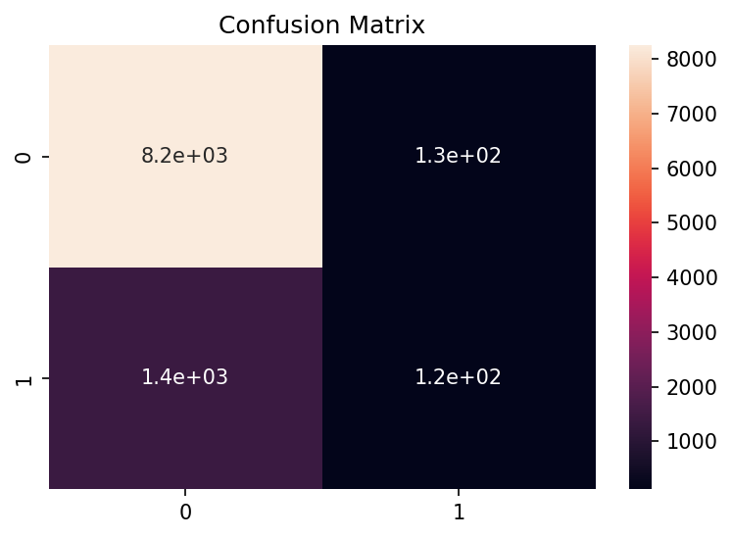
PREDICTING CUSTOMER BUYING BEHAVIOUR
Given by customer_booking Dataset and trained with Multiple Machine Learning Model and Find Best Accuracy with XGBClassifier Model with all features
Accuracy : 84.85
AOC Score : 0.53

